Slide 1
INTELLIGENT ALERT SYSTEM FOR FOREST TRIBAL PEOPLE
Submitted by
TEAM – 19(ML Interns – 4TH May, 2020)
SRAVIKA JULOORI
SINGAM CHANDANA REDDY
RAJKAMAL GOUD VUTUKURI
BIPIN GANJI
RAHUL TEJA

Slide 2
EXISTING PROBLEM:
All the tribal populations of India were traditionally closely associated with forests, and there are some who even today spend the greater part of their lives in the proximity of trees and villages or clans near to forest. If any dangerous predators when entered into a village or clan may lead to loss of resources or in extreme cases leads to loss of life.

Slide 3
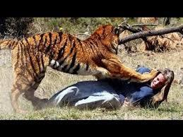
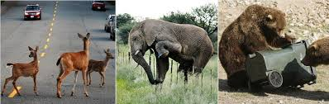
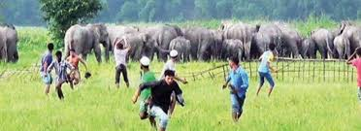
PURPOSE:
There is a high level of human–wildlife conflict
The local people would have less favourable attitudes towards problematic wild animals.
The major types of human−wildlife conflict are
Hence we came up with this “Intelligent Alert System”.

Slide 4
PROPOSED SOLUTION:
The proposed Intelligent alert system for forest tribal people model is based on neural networks (CNN) incorporated with an alerting system. This system will monitor the entire villages of surrounding forests at regular intervals through a camera. Once any dangerous animal is detected then it will send information to the people in the village and it will produce an appropriate sound or alarm in the village to alert the people.

Slide 5
SOFTWARE/HARDWARE DESIGNING:
SOFTWARE:
Anaconda
Jupyter notebook
Python web frameworks
HARDWARE:
Cameras
Laptop

Slide 6
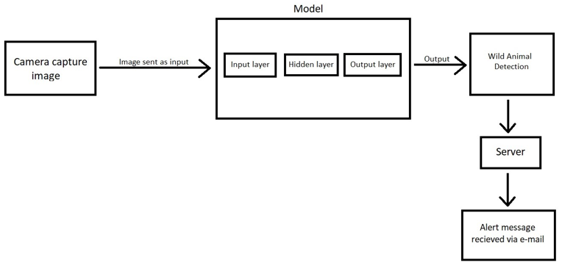
THEORITICAL ANALYSIS:
BLOCK DIAGRAM:

Slide 7
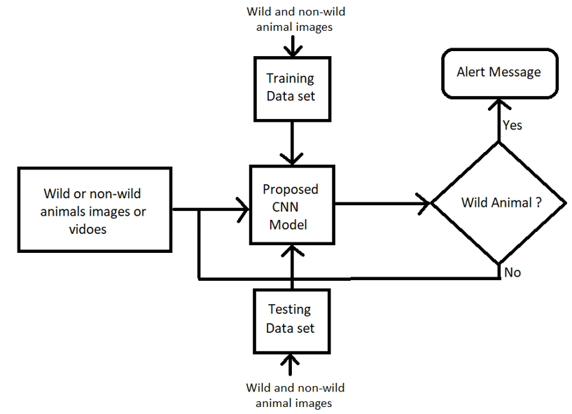
FLOWCHART:

Slide 8
ADVANTAGES & DISADVANTAGES
ADVANTAGES:
Low cost
No need for manual guarding
Can ensure
no crop raiding
no loss of domestic life due to livestock predation
decrease the risk of livestock diseases
Safeguarding human life and wildlife as well.

Slide 9
DISADVANTAGES:
Blurred detections may not work properly.
Not everyone may have facility to access mobile/device.
Limited sample size.
Disturbance effects.
Technical failures.

Slide 10
CONCLUSION:
We conclude that the computing world has a lot to gain from neural networks as it offers more natural interaction with the real world.
Biodiversity is our life. If the Biodiversity got lost at this rate then in near future, the survival of human being will be threatened. Hence the world needs many more applications like this with evolving technologies for human safety and to conserve biodiversity.

Slide 11
FUTURE SCOPE:
To be sure advances in hardware (high resolution cameras), storage, parallel processing architectures will enable even greater leaps in the functionality of this Intelligent Alert System thereby reducing human-wildlife conflict.
However the field of Artificial Intelligence will remains in its infancy.

Slide 12
THANK YOU
FOR WATCHING!

